Slide 1
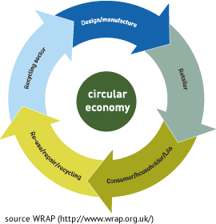


KMUTT’s Capability and Innovations in Circular Economy-Biogas, Bioplastics & Beverage
Mr. Arslan Siddique
Ms. Benjarong
STEAM platform KMUTT
Circular Economy (CE)

Slide 2
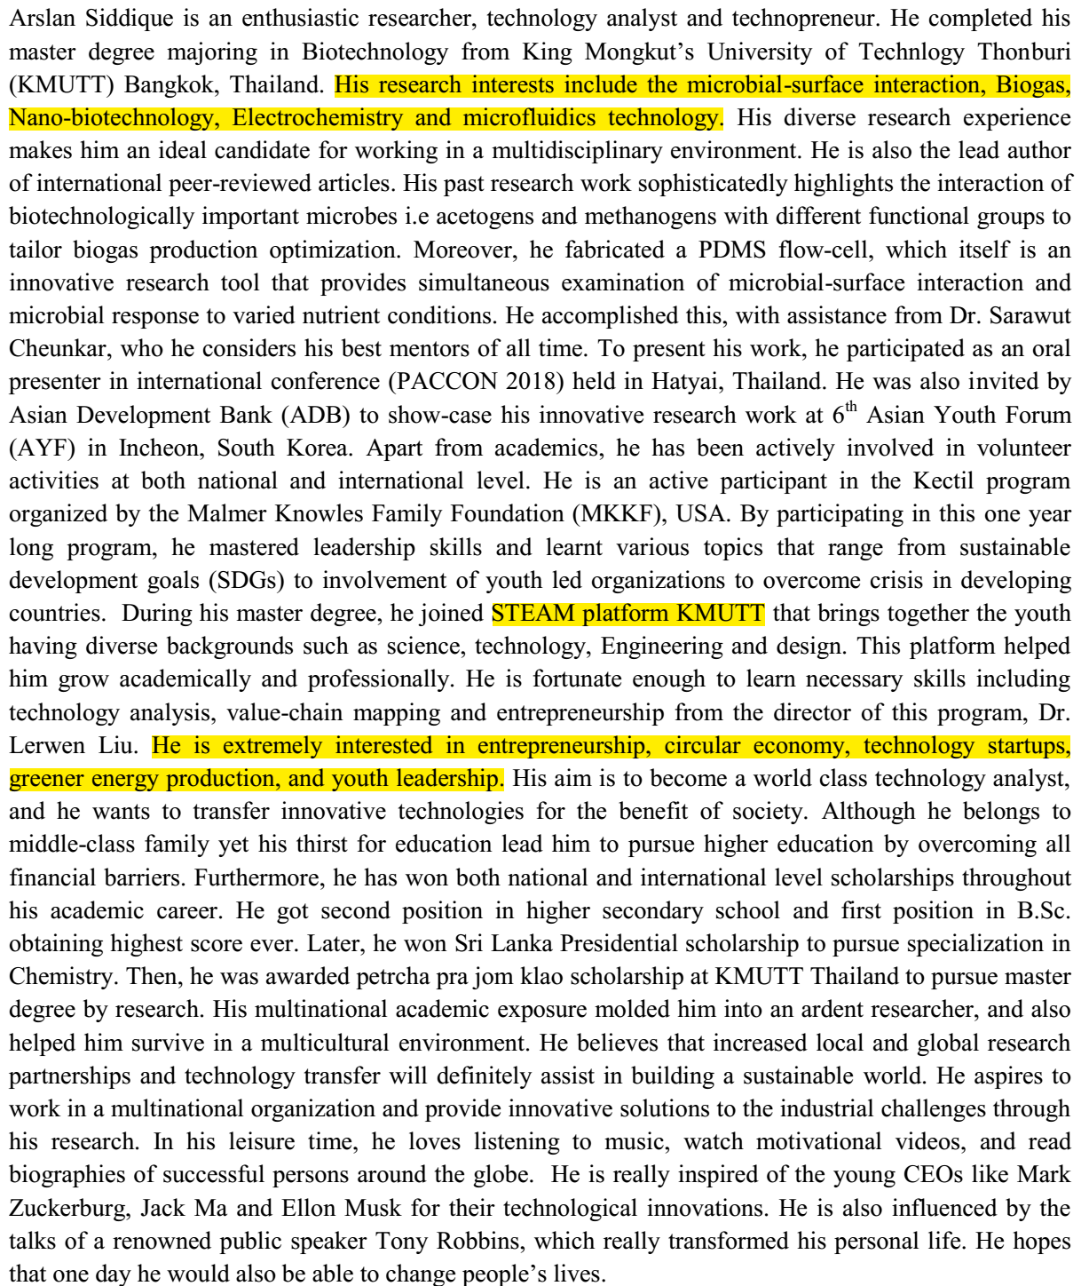
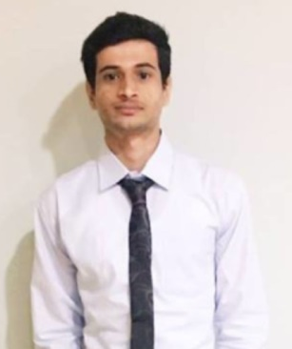

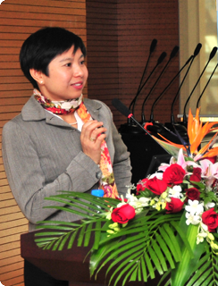
Biography-Arslan Siddique
Mr. Arslan Siddique
M.Sc. Biotechnology
STEAM
Dr. Lerwen Liu
PhD Physics

Slide 3

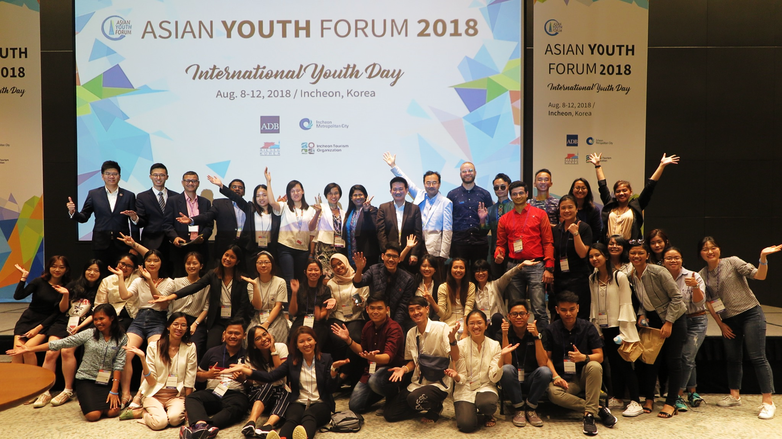
STEAM Focus
KMUTT Youth-team
Leadership
Innovation
Entrepreneurship & Global Partnership

Slide 4

Circular Economy-Value Chain
Pretreatment
Processing
Product
Consumers
Raw Materials
Waste

Slide 5
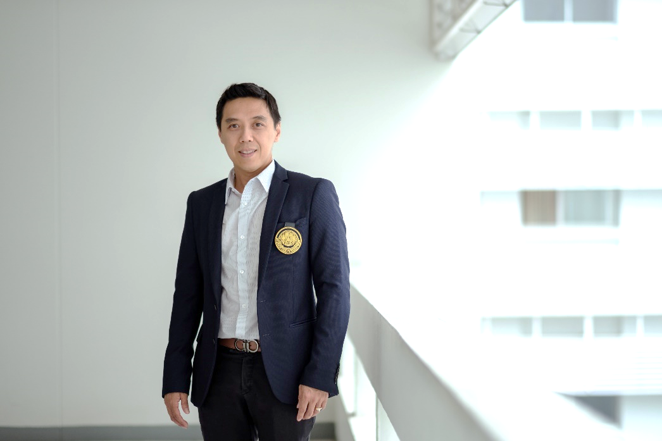
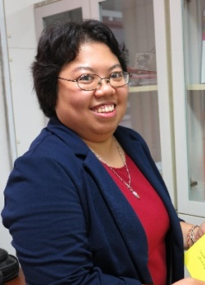
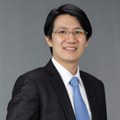
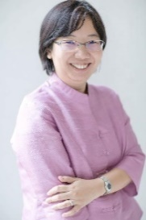
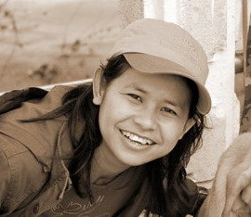
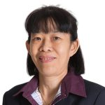

Circular Economy-Biogas
Assoc. Prof. Chakrit Tachaapaikoon
Enzyme Technology lab, SBT
Asst. Prof. Dr. Treenut Saithong
Biological modeling laboratory, SBT
Anaerobic digestion
Sugars and volatile fatty acids
Biogas for electricity and heating
National Grid,
Household
Food waste, Cassava
Waste
Prof. Dr. Navadol Laosiripojan
Integrative Biorefinery Laboratory, JGSEE
Dr. Warinthorn Songkasiri
ECoWaste lab, KMUTT
Dr. Benjaphon Suraraksa
ECoWaste lab, PDTI
Dr. Pawinee Chaiprasert
ECoWaste lab, KMUTT
Dr. Sarawut Cheunkar
ECoWaste lab, PDTI

Slide 6
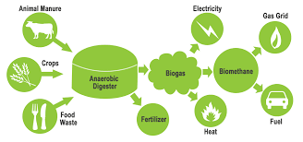
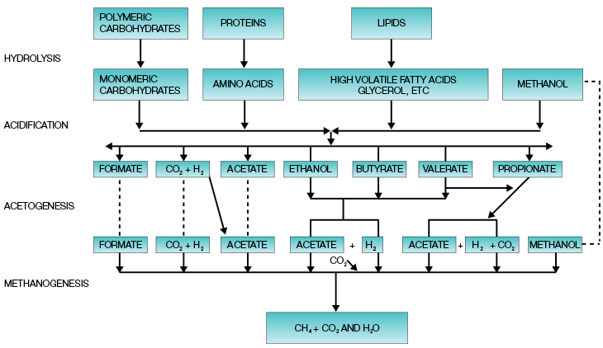

Production
Rice Straw (Xylan)→Chemical pretreatment→ Xylose or glucose
One Step Saccharification of rice straw using bacterial (Clostridium thermocellum) derived cellulolytic and xylanotic enzymes.
Glucose yield increased from 56% to 86% using this technology.
Prediction of cassava protein intercome based on Inter-log method.
This method helped in precise prediction (protein-protein interaction and domain-domain interaction) in the widely used cassava as feed stock, which helps in trait improvement.
Anaerobic granulation for effective substrate utilization.
Addition of MEM-8265 polymer enhanced the aggregation of microbes reducing nucleation time and higher distribution.
Increase in size of granule (> 120 µm) for enhancing substrate utilization.
Fabrication of PDMS Flow cells for investigation of microbes employed in biogas production.
Microbial-surface interaction especially microbial attachment on differently modified surfaces.
Studying microbial response to varied acidity for optimization of the biogas production.

Slide 7
Oum and James-RIPO KMUTT

Slide 8
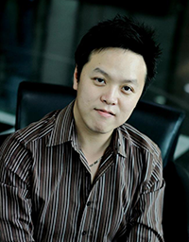
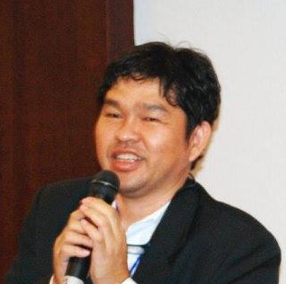
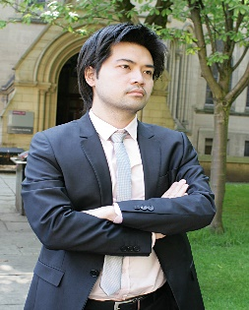
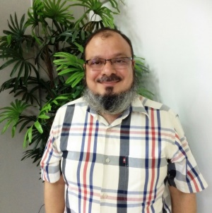

Circular Economy-Bioplastic
Dr. Verawat Champreda
Enzyme Technology lab, SBT
Pretreatment
Cellulose, hemicellulose, lignin
Bioplastic
Household and industries
Cassava and Sugar Cane
Waste
Asst. Prof. Dr. Treenut Saithong
Biological modeling laboratory, SBT
Prof. Dr. Navadol Laosiripojan
Integrative Biorefinery Laboratory, JGSEE
Dr. Annop Nopharatana
ECoWaste lab, KMUTT
Dr. Supachok Tanpichai
PENTEC, KMUTT
Prof. Shabbir H. Gheewaal
LCA lab, JGSEE
Asst. Prof. Panchan Sricharoon
Chemical Engineering, KMUTT

Slide 9
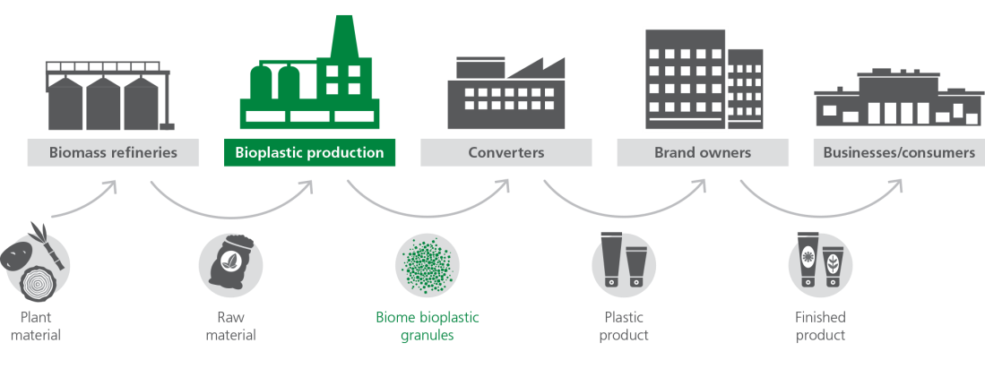
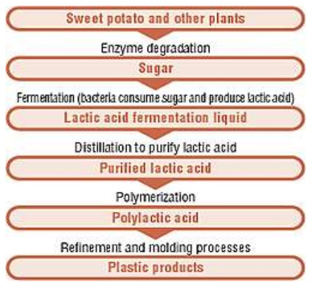
Production
Starch conversion by solid acid catalyst in mixed milling process.
HA-L-SO3H gave efficiency of 93% starch conversion with 83% selectivity.
Enhanced selectivity as well as rate of starch depolymerization.
Higher catalytic activity, recyclability and ease of separation.
Separation of lignocellulosic constituents and hydrolysis of polysaccharides for biofuel production.
Organosolv separation form sugarcane bagasse and saccharification using H₃ PO₄ –activated carbon.
89% recovery of cellulose and 86% recovery of hemicellulose from bagasse.
Catalyst retained >80% activity after reusing for five consecutive batches.
Improvement in the mechanical properties of the Polylactic acid (PLA) fibers used for making bioplastic.
Addition of clay improved, process-ability, morphology and filtration efficiency of electrospun PLA fibers.

Slide 10
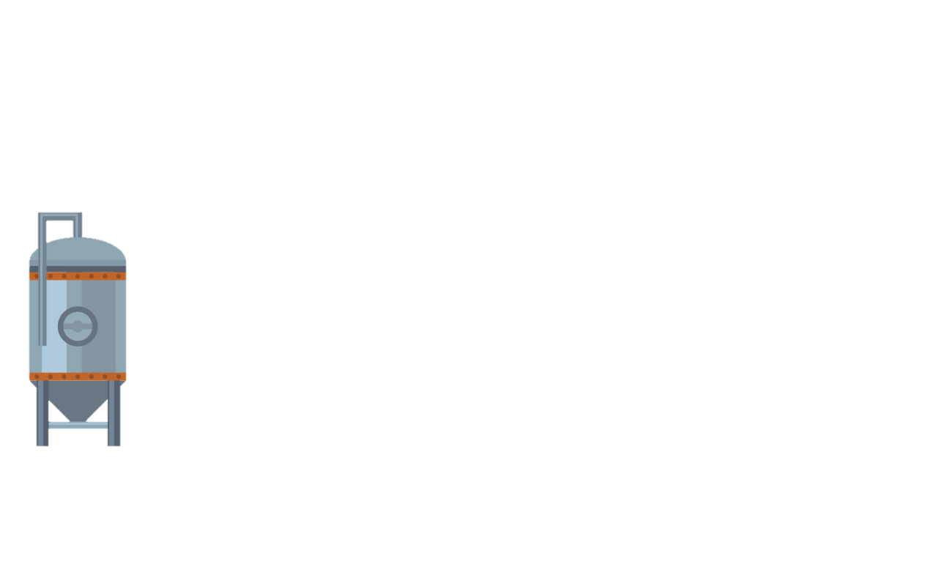
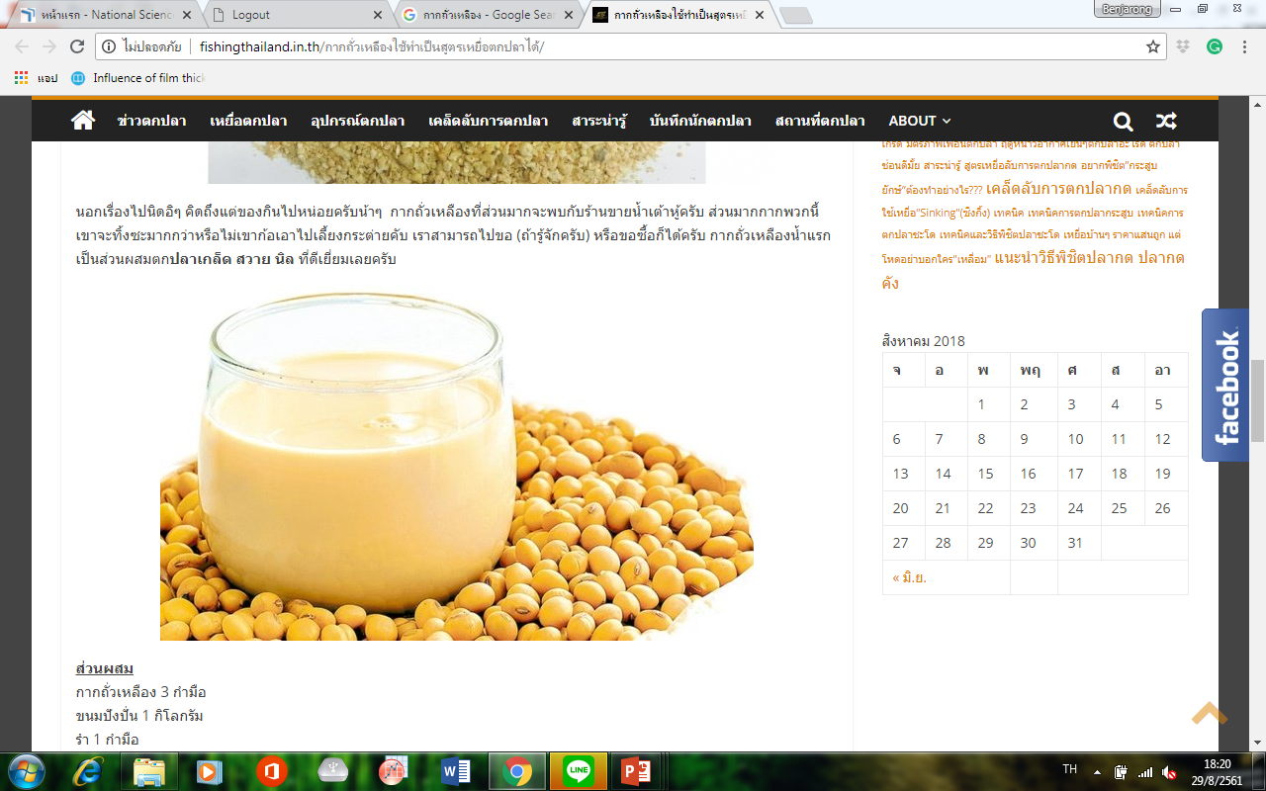
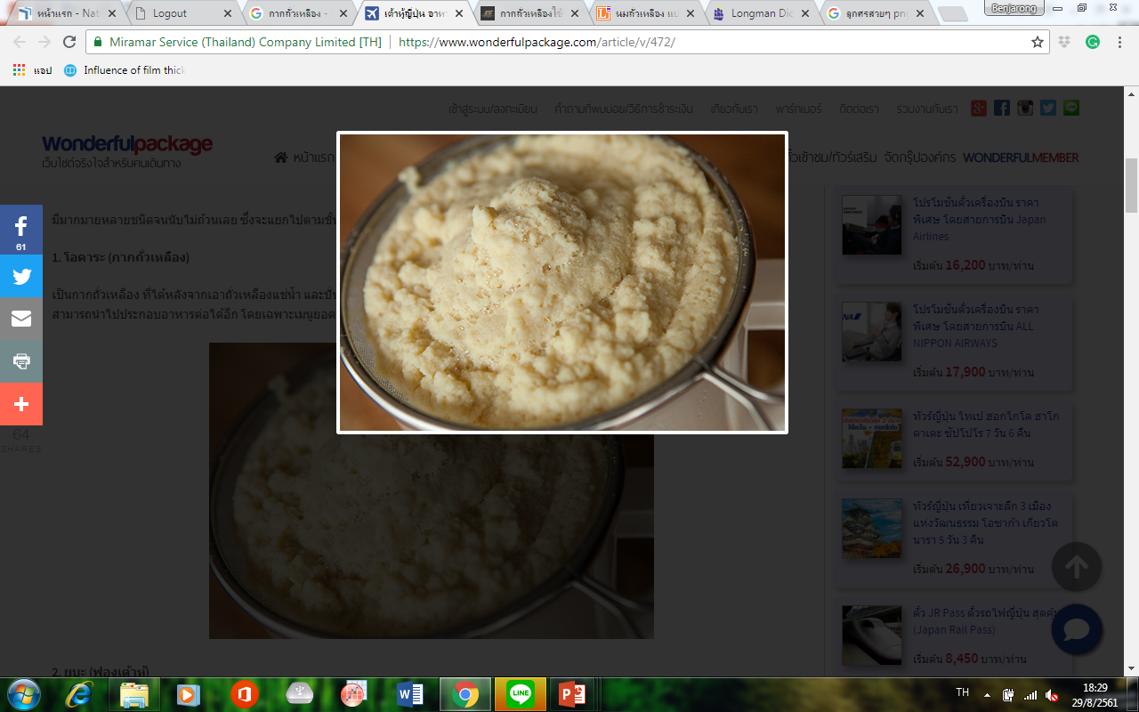

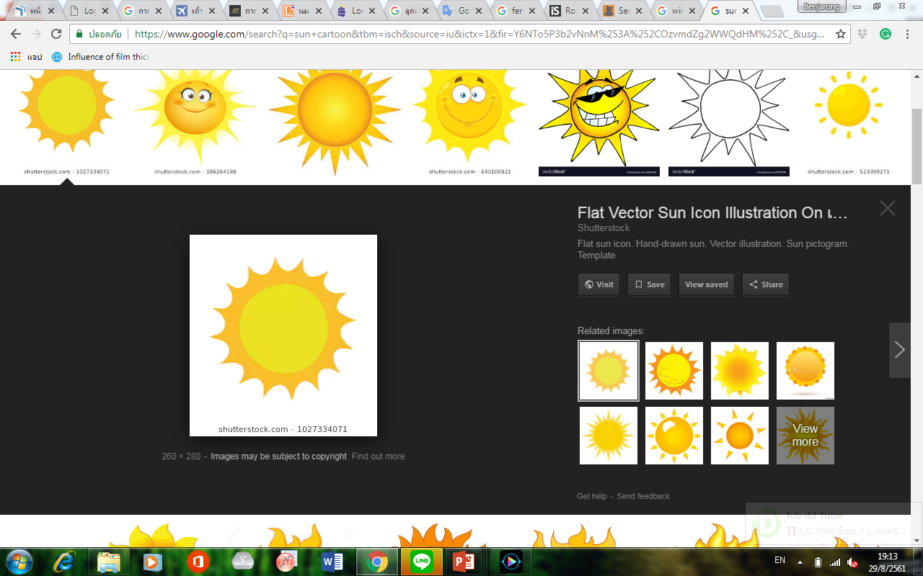
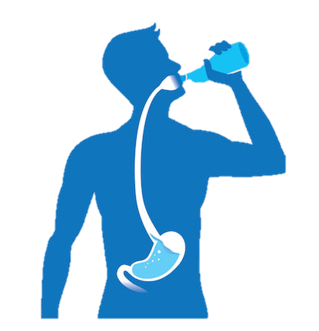
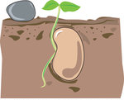

Circular Economy-Food and Beverage
Production
Bio-waste
How to produce?
Soybean Milk
Soybean Meal
Production
of Alcoholic
Beverages
Manure
Wine
Consumer

Slide 11

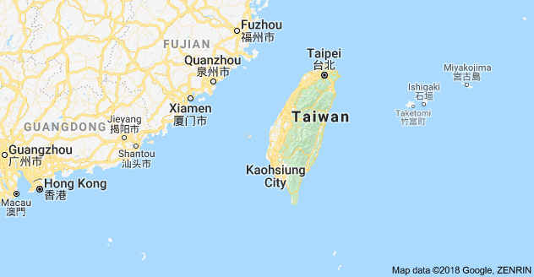
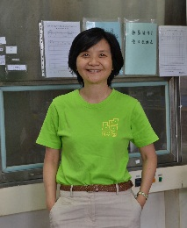
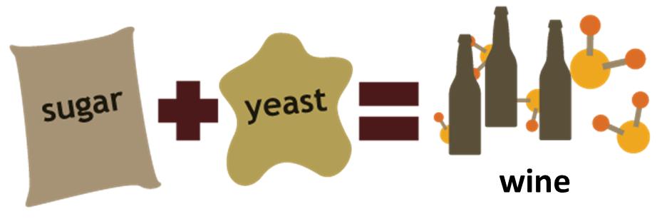


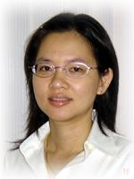

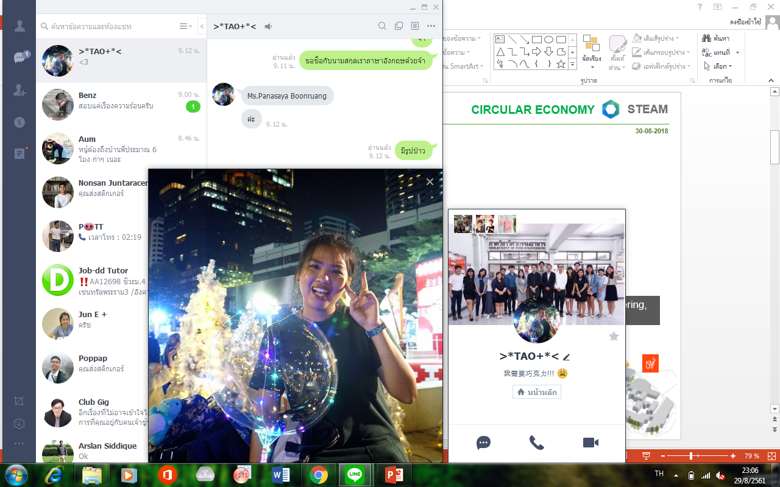
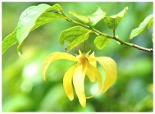

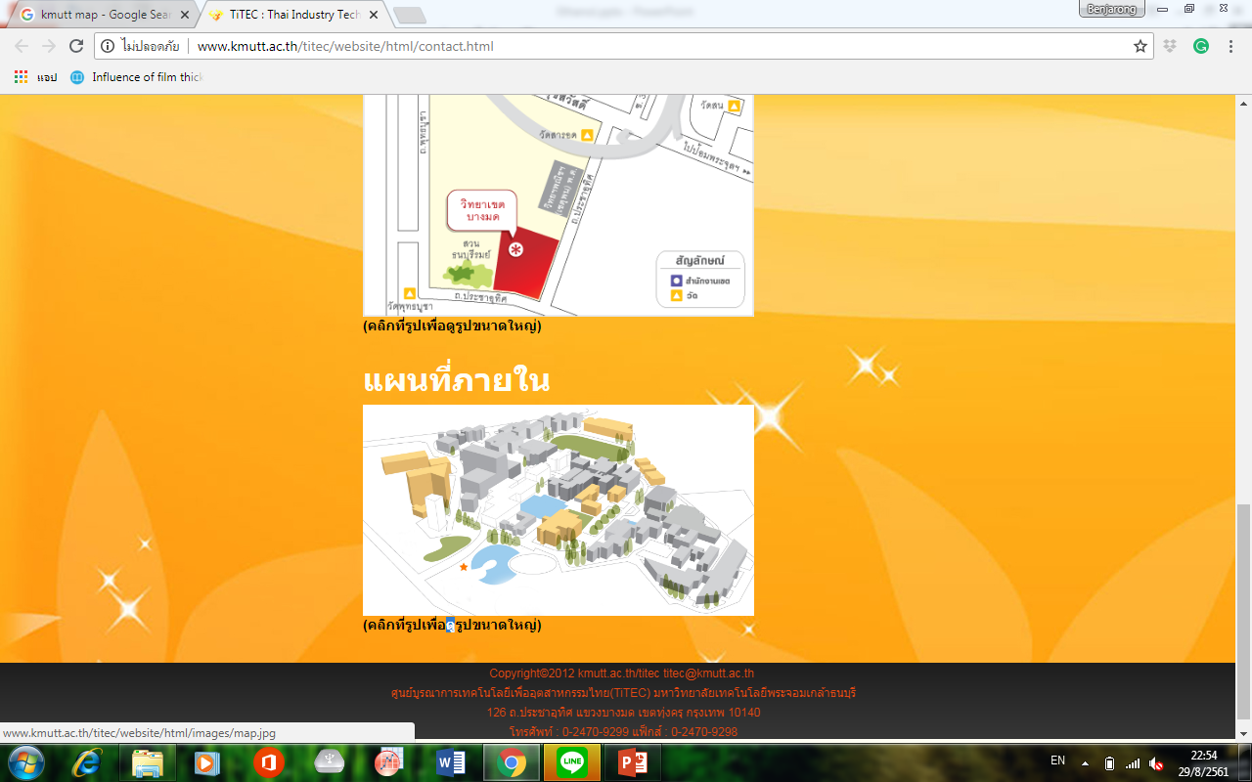
General process
Fermentation
fruit
Prof.Dr. Chiu-Hsia Chiu
Food microbiology laboratory,
food science department faculty of Agriculture
at National Pingtung University of Science and Technology
Soybean Meal
Synthesis: Cyberlindnera sp.
From Desmos chinensis
Assoc. Prof.
Naphaporn Chiewchan
Asst. Prof.
Suvaluk Asavasanti
Ms.
Panasaya Boonruang
Digestion
Department of food engineering,
faculty of engineering
Carbohydrate
Ethanol
Wine
Protein
Esters
Lipid
Esters
Can be adjusted to the smell of wine from soybean meal

Slide 12
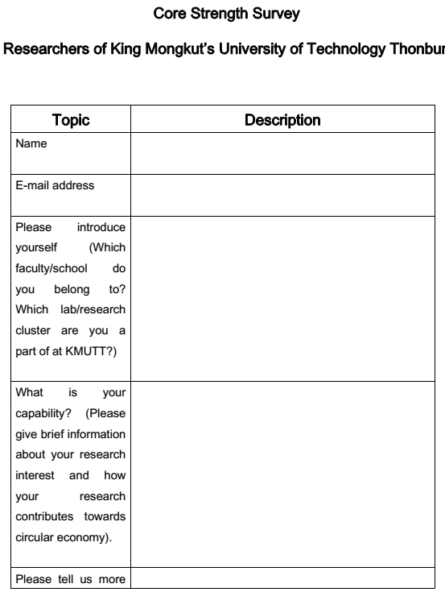
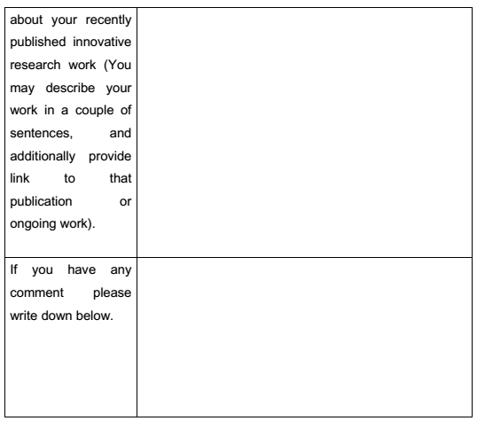
Capability and Innovation Survey-STEAM KMUTT
Steamplatform.org

Slide 13


